Slide 2
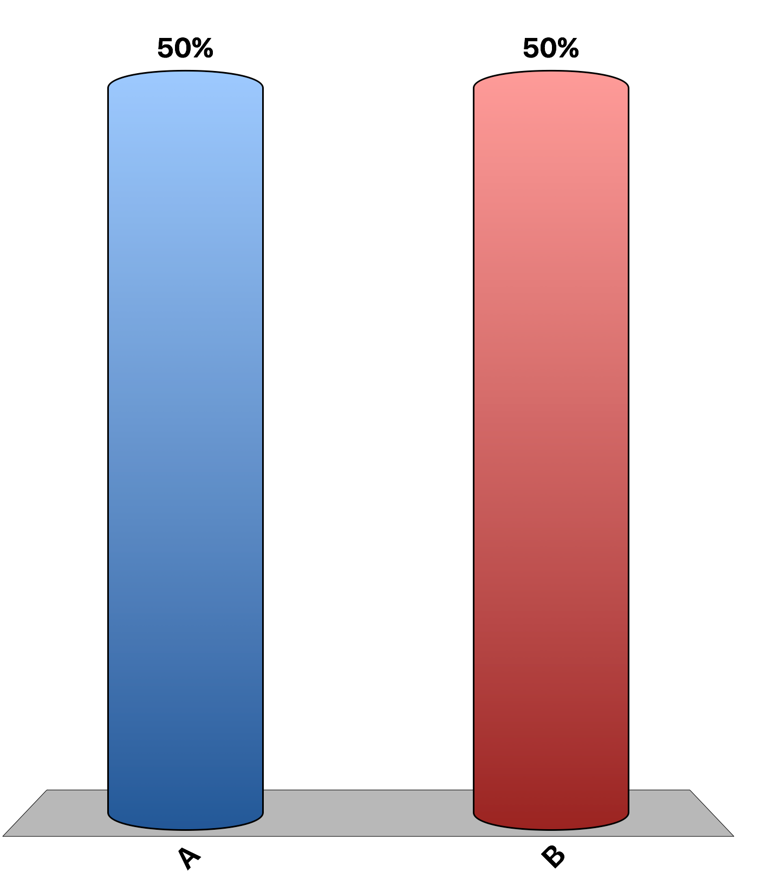
When the government imposes a binding price ceiling, it causes a surplus of the good.
True
False

Slide 3
A $2 tax levied on the producers of a good has the same effect on buyers and sellers as a $2 tax levied on the consumers of the good.
True
False

Slide 4
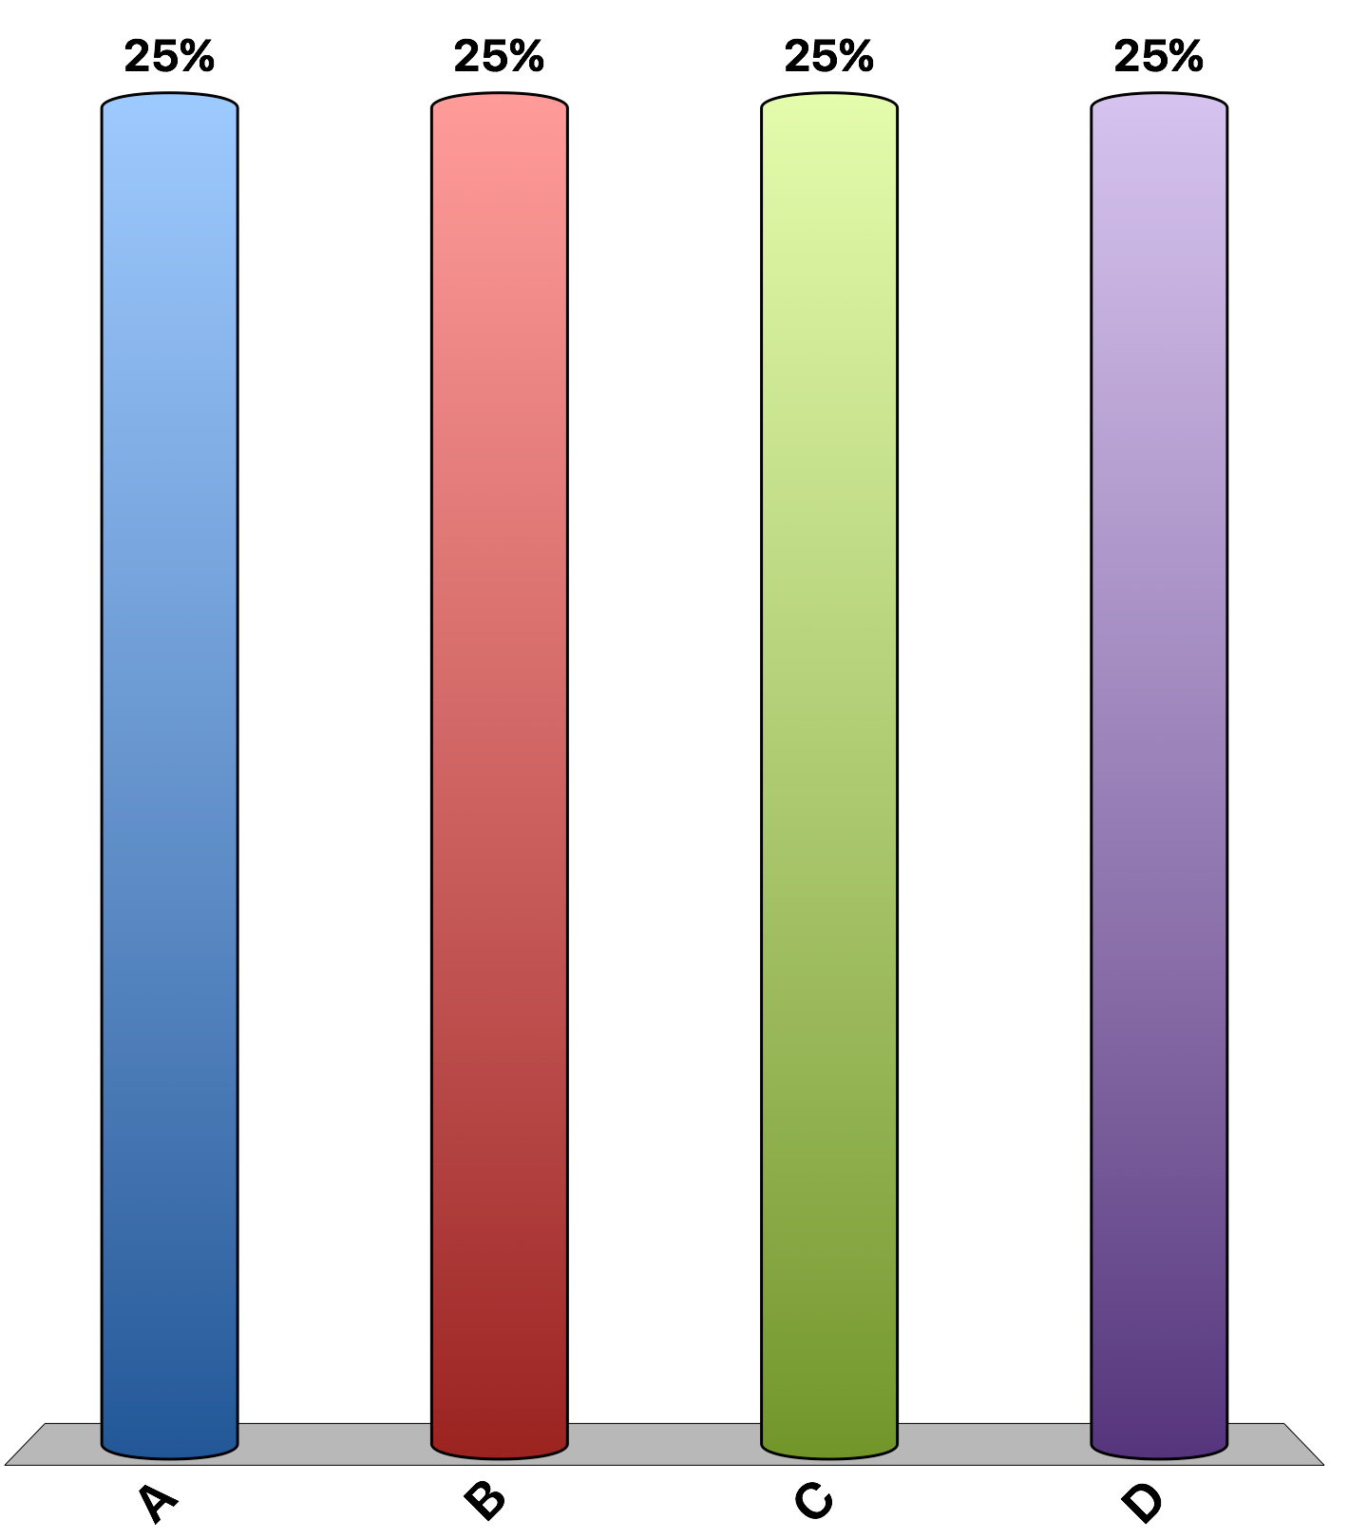
Rent controls cause
shortages of apartments in both the short run and long run of similar magnitudes.
surpluses of apartments in both the short run and long run of similar magnitudes.
shortages of apartments which are larger in the short run than in the long run.
shortages of apartments which are larger in the long run than in the short run.

Slide 5
Which of the following would not be a result of a binding price ceiling on child care?
a quantity of child care demanded greater than quantity supplied
a decrease in quality of care
an increase in the quantity of child care supplied
a lower price of childcare.

Slide 6
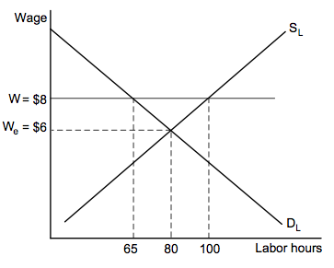
Refer to the labor market graph. The imposition of an $8 minimum wage would cause
tax revenues to increase by $2 per worker.
unemployment of 35 labor hours.
a labor shortage of 35 labor hours.
no change in the equilibrium wage and employment because the minimum wage is not binding.

Slide 7
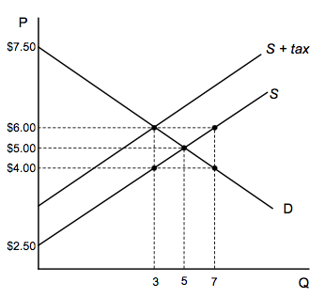
The market for gluten-free breakfast cereal is shown in the graph above. Suppose the government enacts a $2 tax per unit, imposed on the sellers. The policy will cause:
the equilibrium price of gluten-free breakfast cereals to rise by $2.
buyers to bear a higher burden of the tax than sellers.
buyers and sellers to each bear a $1 burden of the tax.
a shortage of gluten-free breakfast cereals.

Slide 8
Suppose that the City of Bloomington imposes a $1 per-tire recycling fee on buyers whenever they purchase a new tire. We can illustrate the tax on a graph by shifting the demand curve
down by $1; the price received by sellers would fall by $1.
up by $1; the price received by sellers would rise by $1.
down by $1; the price paid by buyers would rise by less than $1.
up by $1; the price paid by buyers would fall by less than $1.

Slide 9
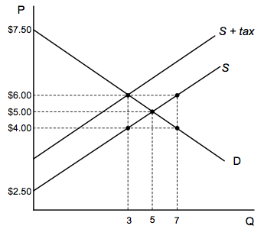
The market for gluten-free breakfast cereal is shown in the graph. The after-tax price paid by buyers and price received by sellers are, respectively,
Price paid by buyers Price received by sellers
$4.00 $6.00
$5.00 $6.00
$6.00 $5.00
$6.00 $4.00

Slide 10
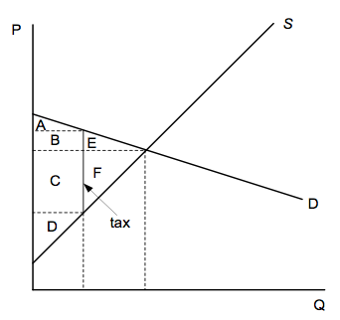
Assuming the graph is drawn to scale, which of the following is true regarding the burden of the tax in market above?
Buyers pay a larger share of the tax because demand is more elastic than supply.
Sellers pay a larger share of the tax because supply is more inelastic than demand.
Sellers pay a larger share of the tax because supply is more elastic than demand.
Buyers pay a larger share of the tax because demand is more inelastic than supply.

Slide 11
In 2015, the minimum wage according to federal law was $7.25 per hour. Increasing minimum wage to $8 per hour (approximately a 10% increase) will probably lead to:
higher income for the working poor
1-3% increase in teenage unemployment
more teenagers dropping out of school and preventing some unskilled workers from getting the on-the-job training they need
All of the above

Slide 12
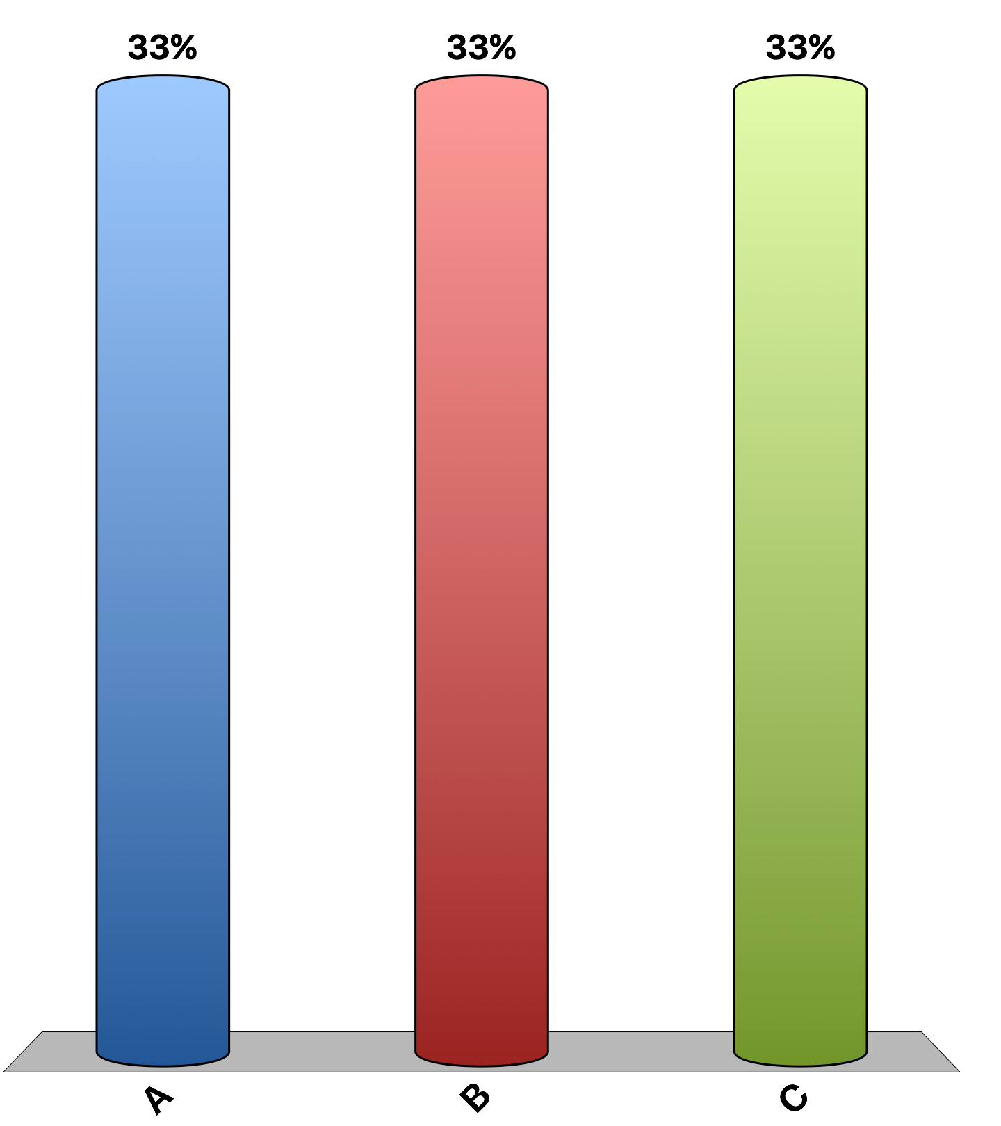
“Local ordinances that limit rent increases for some rental housing units, such as in New York and San Francisco, have had a positive impact over the past three decades on the amount and quality of broadly affordable rental housing in cities that have used them.”
agree
disagree
uncertain
Notes:
1% of economists agree, 95% disagree, 4% uncertain. This is the 'Ask the experts' feature in the textbook. Source: IGM Economic Experts Panel, February 7, 2012.

Slide 13
“If the federal minimum wage is raised gradually to $15-per-hour by 2020, the employment rate for low-wage U.S. workers will be substantially lower than it would be under the status quo.”
agree
disagree
uncertain
Notes:
34% of economists agree, 29% disagree, 37% uncertain. This is the 'Ask the experts' feature in the textbook. Source: IGM Economic Experts Panel, September 22, 2015.

